Slide 1
Sentinel- A Sentimental Analysis engine
TEAM MEMBERS PROJECT GUIDE
Infant Maria Jose . S Thamotharan.B
116014040 APIII/ICT/SOC
Sridhar. B
116014098

Slide 2
Agenda
Scope of the Project
Existing model
Challenges in the existing model
Proposed model

Slide 3
SCOPE OF THE PROJECT
To provide benefits to customers and e-commerce website provider.
To enhance the rapidness to the generation of the results.
To reduce the waiting time that optimizes turnaround time.

Slide 4
EXISTING MODEL
Obtains the requirements of the customers, and returns the appropriate results.
Naive Bayes Classifier :
  Independent assumptions for feature extraction.
Bag of words:
Text is represented as multi set of its words, disregarding grammar an even word order.

Slide 5
CHALLENGES IN THE EXISTING MODEL
Provides final results only on specifications but not on the feedbacks.
A lag exists between the Insight development time, and performance Improvement, in the existing version.

Slide 6
PROPOSED MODEL
Provide final results only on feedbacks.
Unlike the Naïve Bayes’ classifier the Max Entropy does not assume that the features are conditionally independent of each other.
Words are the features in this context.
The lag between the insight and development time is reduced.

Slide 7
SYSTEM PLANNING

Slide 8
TIME SCHEDULE FOR VARIOUS MODULES
MODULE 1:
Phase 1: Literature Survey -21.12.2015 – 09.01.2016
Phase 2: Front end and Database Design -13.01.2016 - 06.02.2016
MODULE 2:
Phase 1: Natural Language Processing -06.02.2016-24.02.2016
Phase 2: Manipulate Semantics -24.02.2016-08.03.2016
MODULE 3:
Phase 1: Implementation -08.03.2016 - 25.03.2016
Phase 2: Manipulation ,Testing using Python -25.03.2016- 07.04.2016

Slide 9
FUNCTIONAL REQUIREMENT ANALYSIS

Slide 10
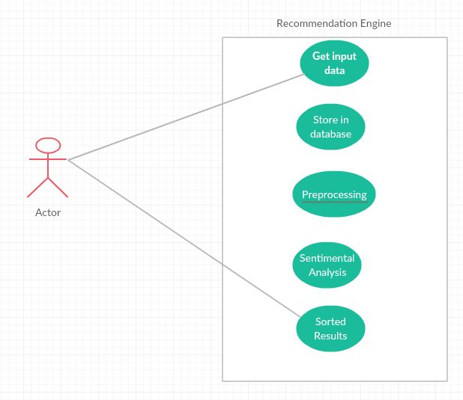
Use case Diagram

Slide 11
Data Flow Diagram
HTML
MySQL
NLP
Data Preprocessing
Python
Analysing
Assign Polarity Values

Slide 12
NON FUNCTIONAL REQUIREMENTS

Slide 13
RESOURCE REQUIREMENTS
SOFTWARE:
  Python-Version 2.7
  MySQL
  HTML
  Flask Web framework
  peewee- Object Relation mapping for flask
  Natural language processing toolkit (NLTK)
HARDWARE:
  INTEL processor
  2GB RAM
  Linux Operating System

Slide 14
REFERENCES
S.Poria, B.Agarwal, A.Hussain, A.Gelbukhand, N.Howrd, “dependency-based semantic parsing for concept–level text analysis”, on Intelligent Text Processing and Computational Linguistics, (CICLing’14), vol.8403, pp.113-127, 2014.

Slide 15


